Slide 1
UNIT 4: For Live Session
Chad Madding

Slide 2
Optimization
Does your work or the company you work (or one you have worked for in the past … or one you would like to work for) for currently make use of prescriptive statistics? Optimization?
We are now using time data collected through Team Dynamics to look at resource management.
Could your company (or one you have worked for in the past … or one you would like to work for) take advantage of prescriptive statistics?
The above data has lead to the use of prescriptive statistics in budgeting and predicting future project management resource needs.

Slide 3
GINI SCORE
Gini Coefficient Formula
Gini Coefficient = A / A + B
If A=0, the Lorenz curve is the line of equality. When A=0, the Gini index is 0. A large Gini coefficient indicates there is huge income/wealth inequality.
Definition of Price Dispersion:
Price dispersion is looking at different prices in the market for the same item. In the airline industry this is typically a seat on the plane. We can use the Gini Coefficient to measure different effects on ticket price based on different events like one-way markets verses the round-trip market.

Slide 4
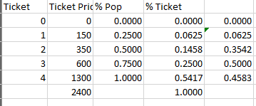

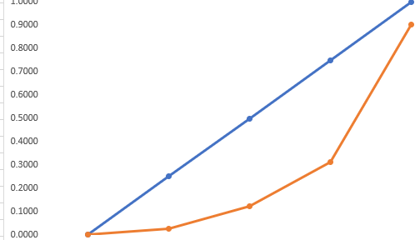
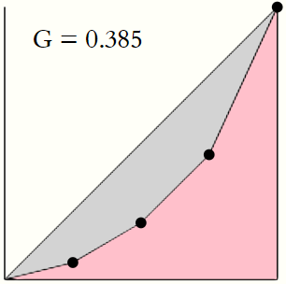
Calculate a GINI score for:
Ticket Prices: $350, $150, $600 $1300

Slide 5

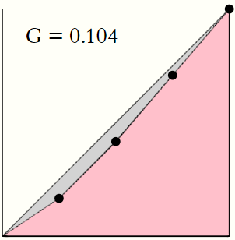
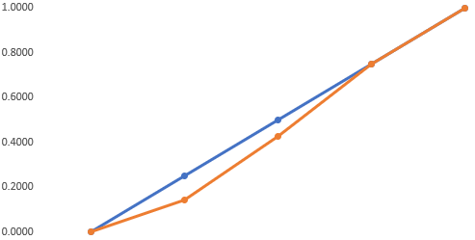
Calculate a GINI score for:
Ticket Prices $600, $400, $700, $700
Ticket | Ticket Price | % Pop | % Ticket
0 | 0 | 0.0000 | 0.0000
1 | 400 | 0.2500 | 0.0417
2 | 600 | 0.5000 | 0.1250
3 | 700 | 0.7500 | 0.2188
4 | 700 | 1.0000 | 0.2917
 | 2400 |  | 0.6771

Slide 6
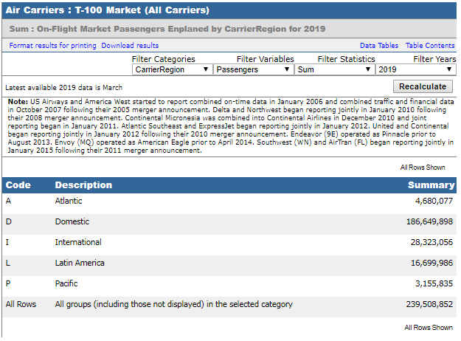
Investigate the Data Sources.
A snapshot Air Carrier Statistics database.

Slide 7
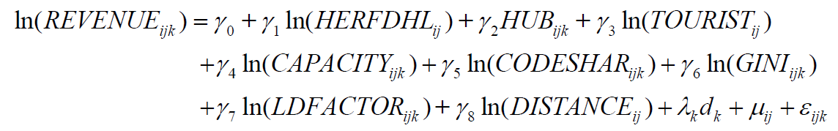
Investigate the model for Revenue
Specify the model (what is the mathematical form of the model?)
This model can be estimated using ordinary least square (OLS)

Slide 8
Investigate the model for Revenue
Define endogenous vs. exogenous variables
Endogenous Variables – These are variables that are determined or influenced by other independent variables in the data set. There was an example at www.statisticshowto.datasciencecentral.com that talked about sugar being an endogenous variable because the demand in the data set could be affected by things like weather or insects.
Exogenous Variables – This is a variable that is not affected by other variables in the system. “Statistics How To”

Slide 9
Investigate the model for Revenue
What are the 3 methods of parameter estimation considered?
OLS
Random Effects
Hausman-Taylor (HT)

Slide 10
Investigate the model for Revenue
Why were the OLM estimates not recommended?
They tested the route effects to see if they were significant. They used the “Lagrange multiplier (LM) test for the random effects model based on the OLS residuals”. Page 18 They found that the route effects were significant so the OLS models were not appropriate.

Slide 11
Investigate the model for Revenue
Was multicollinearity an issue? Why or why not?
There is a quote on page 18 that addresses multi-collinearity:
“We test for multi-collinearity among the independent variables by calculating the variance inflation factor (VIF) for all the independent variables. All of the VIF-values are below the threshold of 10. Consequently, multi-collinearity should not be a problem in our specifications (Besley et al. 1980).”
Multicollinearity was not an issue because the VIF values were all below 10.

Slide 12
Investigate the model for Revenue
Which is the “right” model … the model the data were generated from? OLS, Random Effects, Hausman-Taylor (HT)
The “right” model for them was the Hausman-Taylor (HT) model
Thus, we use the Hausman-Taylor (HT) model (Hausman and Taylor 1981, Greene 2003), which uses a two step instrument variable (IV) method to provide consistent estimation of the coefficients. This specification assumes that GINI in Equation (4) and both GINI and LDFACTOR in Equation (5) are endogenous and can be jointly determined. Page 18

Slide 13
Investigate the model for Revenue
Using Table 6, interpret the HT parameter estimate for Load Capacity. Assume this slide is meant for a client or audience that does not have a background in statistics. Phrase your interpretation in the language of the problem and industry.
We wanted to test to see if capacity played any roll in generating revenue. Looking at Table 6 we can see that it does seem to play a highly significant roll. With a P value of less than 0.01 we can see that in random draws of looking at revenue we see that more times than not capacity does play a roll.

Slide 14
Investigate the model for Revenue
Using Table 6, interpret the HT parameter estimate for GINI (price dispersion) Assume this slide is meant for a client or audience that does not have a background in statistics. Phrase your interpretation in the language of the problem and industry. (Does it appear that price dispersion and thus revenue management (RM) is positively associated with revenue (RASM)?
Looking at table 6 we can see that price dispersion (GINI) has a significant positive effect on revenue (p<0.05). This just means that when we ran the data and more times than not we saw the GINI score playing a positive part in revenue management. With the results in this data we can now see that revenue management practices do increase airline revenue.

